Slide 1
Pipelined basic instruction set simulation
Wei Hong and Tengyu Sun

Slide 2
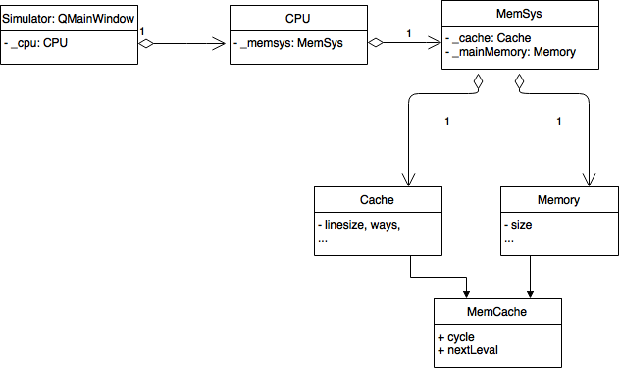
Architecture
Current stage

Slide 3
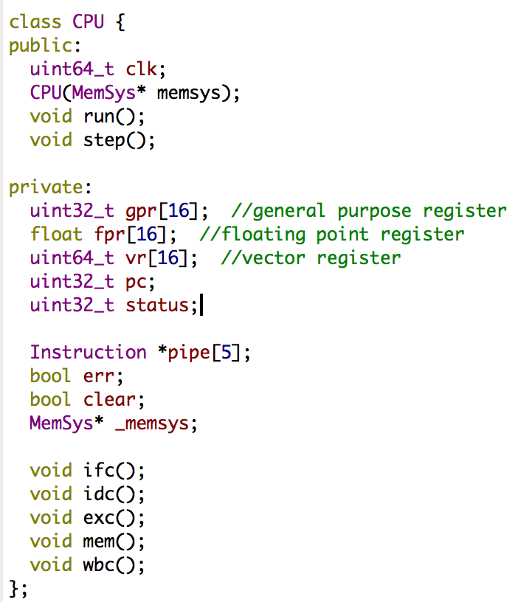
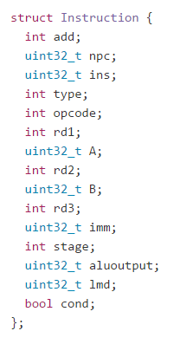
Implementation
Instruction state
5 stages
IF -> ID -> EX -> MEM -> WB
Pipeline
represented as an instruction array of size 5. The instruction objects are passed around the 5 stages
Registers
16 general purpose registers
16 floating point registers
16 vector registers
One program counter

Slide 4
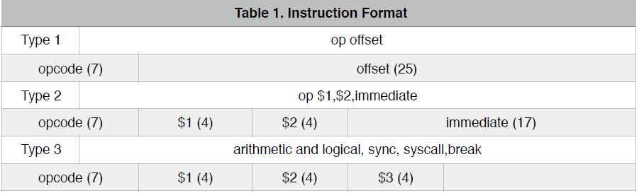
Full ISA support
Data transfer
lb, lbu,sb, lw, sw, lsp, witf, wfti
Arithmetic and logical
add,sub, addi, subi, mul, muh, mulu, muhu, div, divu, modu, and, or, not, xor
Rr, srl, sra, sl, slt, sltu, slti, sltiu
Control
J, jal, beq,bgez,blez, bltz, break
Floating point
addsp, subsp, mulsp, divsp, sltsp
Cache
pref
SIMD
move, copys, copyu, insert, fillb, vaddb, vsubb, vmulb, vdivb
vmodb, ceqb, cleb, cleub, cltb, cltub

Slide 5
Assembler implemenation
2-pass
First pass: load labels into a Map<label, line_number>
Skip blank lines / comments
Second pass:
Take assembly language clauses, parse them into binary instruction.
If labels are encountered, offset is calculated according to the its their line numbers.

Slide 6
Demo 1
Demo 2
preload mem[100] = 1, mem[101]=2
lb $0,$1,100 #$1 = 1
lb $0,$2,101 #$2 = 2
add $1,$2,$3 #$3 = $1 + $2 = 3
bgez $3,L1 #$3>0, branch to sb…
lb $0,$3,100
L1: sb $0,$3,102 #mem[102] = 3
break
preload mem[100] = 1, mem[101]=2
lb $0,$1,100 #$1 = 1
lb $0,$2,101 #$2 = 2
sub $1,$2,$3 #$3 = $1 - $2 = -1
bgez $3,L1 #$3<0
lb $0,$3,100
L1: sb $0,$3,102 #mem[102] = 1
break

